Slide 1
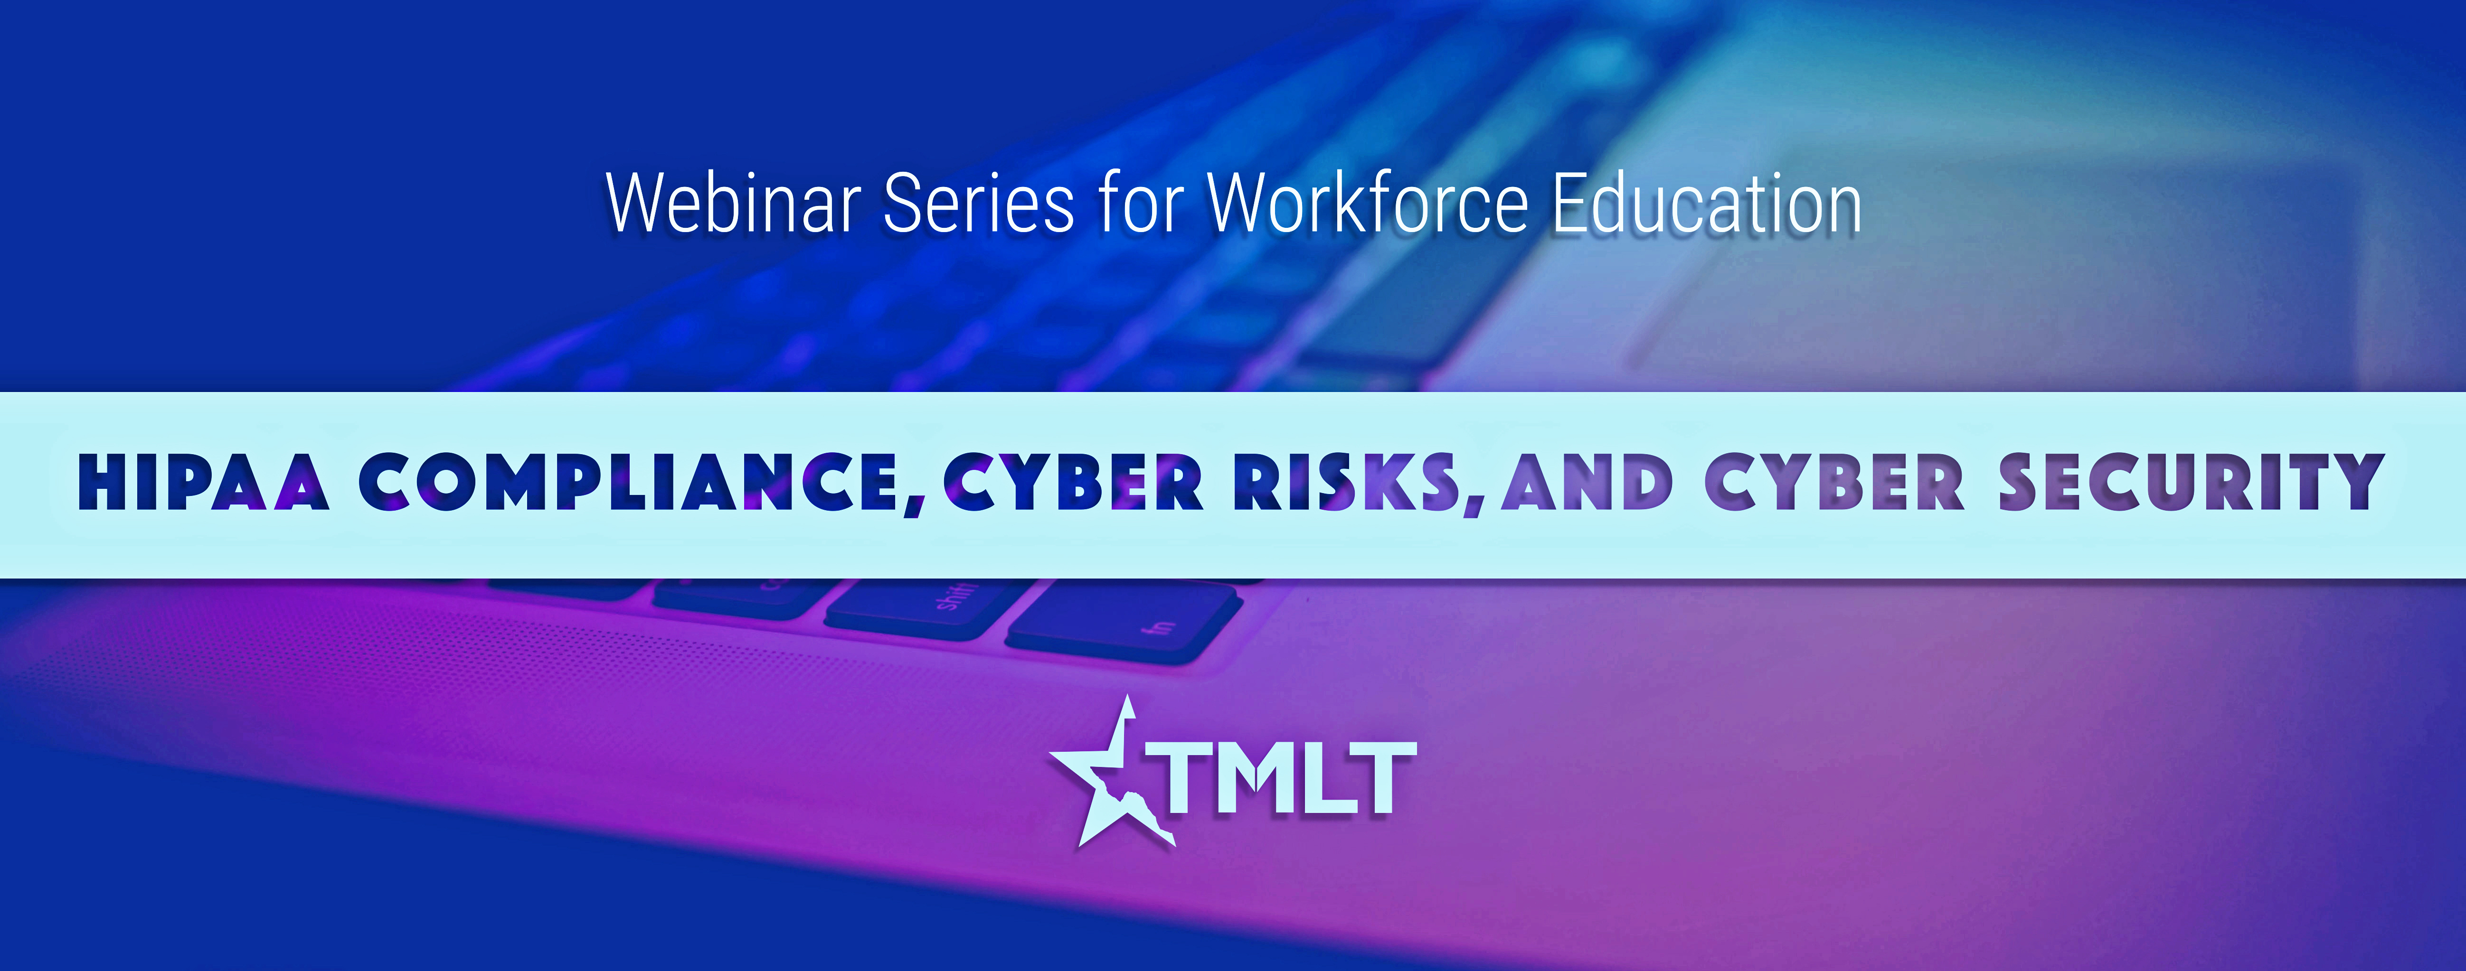
Cyber security basics and hardening your network
Presented by Robert Felps & Ed Jones
September 24, 2019
Notes:
Kassie

Slide 2
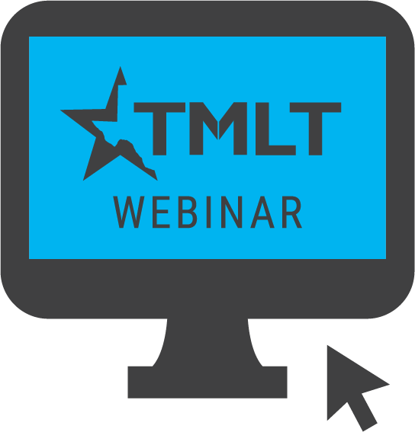
Disclaimer
The information and opinions in this presentation and the supplemental materials are provided “as is” and should not be used or referred to as primary legal sources, nor construed as establishing medical standards of care for the purposes of litigation, including expert testimony. The standard of care is dependent upon the particular facts and circumstances of each individual case and no generalization can be made that would apply to all cases. Neither the presenter, Texas Medical Liability Trust, Texas Medical Insurance Company, or Lone Star Alliance, Inc., a Risk Retention Group warrants the accuracy or completeness of the information presented herein and each disclaims all liability that may arise from the reliance on statements and information presented. The information presented should be used as a resource, selected and adapted only with the advice of your attorney. It is distributed with the understanding that neither the presenter, Texas Medical Liability Trust, Texas Medical Insurance Company or Lone Star Alliance, Inc., a Risk Retention Group are engaged in rendering legal services.
Notes:
Cathy:
There is a Q&A section available to you. If you have a question, you may type it at any time.
We will answer questions at the end of the presentation.

Slide 3
Learning Objectives
Explain HIPAA Security Rule
Understand HIPAA Technical Safeguards
Common Cyber Threats
Password Management
Phishing
Spear Phishing
Malvertising
Work vs Personal Activities
Methods of Cyber Attack
Insider Threats
Signs of Breach
Threat Response
Hardening your Workforce, Systems, Network
This webinar provides basic cyber security knowledge with respect to the HIPAA Security Rule
Provides an overview of computer safety
How to recognize potential threats
How to harden your environment to reduce possibility of a breach
State laws vary. It is important that you become familiar with the privacy and security laws governing healthcare information management in your state.
Notes:
The Learning Objectives include…
By understanding your role as the HIPAA Compliance Officer, you will:
increase your ability to protect your organization’s assets;
protect your patients’ PHI and their identity, more generally; and
minimize the prospect of costly fines for not complying with HIPAA regulations.

Slide 4
CyberConfidence™
Managing cyber risk requires a holistic approach to create a culture of Cyber Confidence.
Leadership
Technology
People
Cyber Risks
Processes
Notes:
Just as health care is moving from thinking episodic care to focusing on more prevention and ongoing and patient-centered care,
cyber security has to also move from “one and done” projects to a holistic and process approach.
A good cyber security approach looks to create resiliency in the organization, to meet the ongoing threats that only continue to become more complex.
Our holistic approach to cyber security and compliance addresses employees, processes, and technology that will help move you to a culture of compliance, accountability, and ongoing protection.
Employees are critical to moving the organization in the right direction. Studies show that changing employee behavior can reduce risk up to 70%. Just to frame the magnitude of health care employee behavior, consider in 2016 it was reported by Identity Theft Resource Center that employee errors accounted for a majority of health care breaches with over 1.1 million records exposed.
Processes have to focus on enabling and engaging employees to protect systems and to have the change management requirements to adjust to the new threats and can be adapted t adapt to new business strategies and initiatives.
At Of course, technology has to look beyond the IT purchases but take into consideration all the wired and wireless devices that your organization uses and interacts with. Think of a house that just doesn’t have a front door and or back door, but multiple, instant entrances that can be created as someone walks in the house.

Slide 5
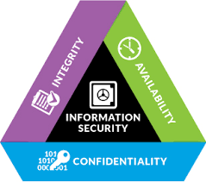
Security Rule – General Requirements
Module 4: Security Rule
“Ensure the confidentiality, integrity, and availability of all electronic protected health information [ePHI] the covered entity or business associate creates, receives, maintains, or transmits.”
45 CFR 164.306
“Protect against any reasonably anticipated threats or hazards to the security or integrity of such information.”
“Protect against any reasonably anticipated uses or disclosure of such information that are not permitted or required by the Privacy Rule.”
“Ensure compliance with this [rule] by the workforce.”
Security rule requirements only apply to ePHI –
not PHI stored on paper or transmitted orally.

Slide 6
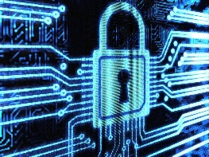
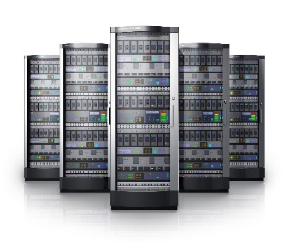
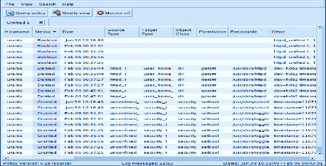
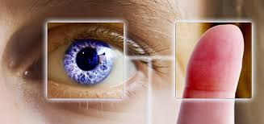
Technical Safeguards - Summary
Module 4: Security Rule
Access controls
- Who?
- What?
Audit controls
- Log of all ePHI activity
- Monitoring of logs
Secure Transmission
Data Center
Person or Entity Authentication
Data integrity
- Uncorrupted (a=a; b=b; …)
- Preserved without loss

Slide 7
Common Cyber Threats
Module 5: Risk Assessment

Slide 8
Password Management
Weak passwords can easily be hacked!
Brute Force Attack – Automated and efficient!
Must be complex, long, and easy to remember, based on a phrase.
Example – MpAb4$f$2ad!
My puppy Abby begs for salmon flavored snacks twice a day!
Never use home personal passwords at work!
Consumer hacks could compromise your organization.
Breaches at Yahoo, Facebook, Google, etc.
Never share your password or write it down.
Have to remember a lot of passwords?
Get a password manager with encrypted vault.
Never store passwords in your browser! Poor security!

Slide 9
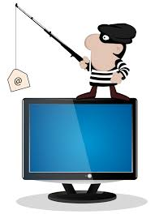
Don’t get caught “Phishing”!
Social Engineering - the use of deception to manipulate individuals into divulging confidential or personal information that may be used for fraudulent purposes.
Phishing is a hacking technique that uses phony emails to trick users into
revealing sensitive account information (e.g., account password) and
installing malicious software (“malware”)
EXAMPLE:
“We suspect an unauthorized transaction on your account. To be sure your account has not been compromised, click the link below to confirm your identity.”
“You have won an Amazon gift card for being a loyal customer.”
Malware can steal more than your account information –
it can steal patient and organization information, too!
Notes:
One of the sneakiest ways hackers have for invading networks is called PHISHING. [Walk thru slide]

Slide 10
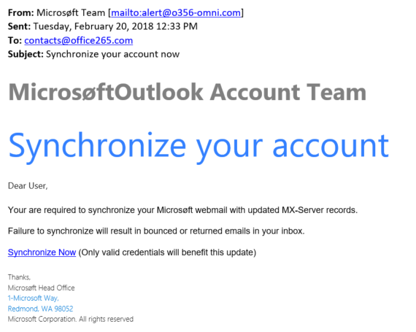
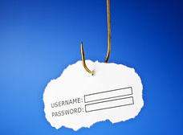
Phishing Example
Email addresses:
Bizarre
Almost correct
Unusual items
Poor grammar
Inconsistencies

Slide 11
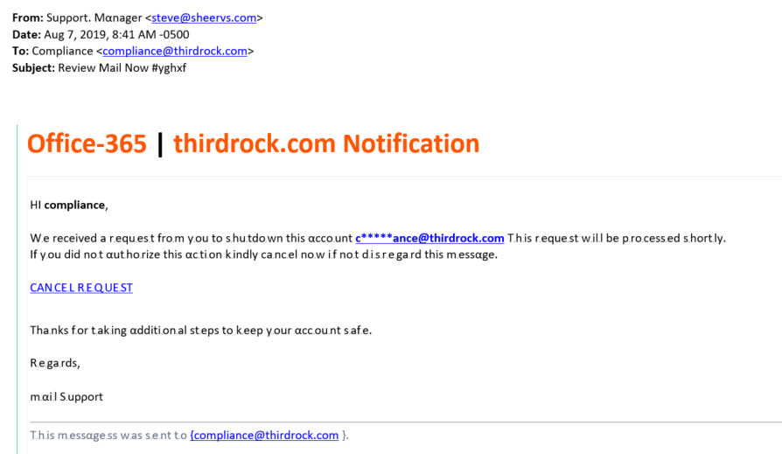
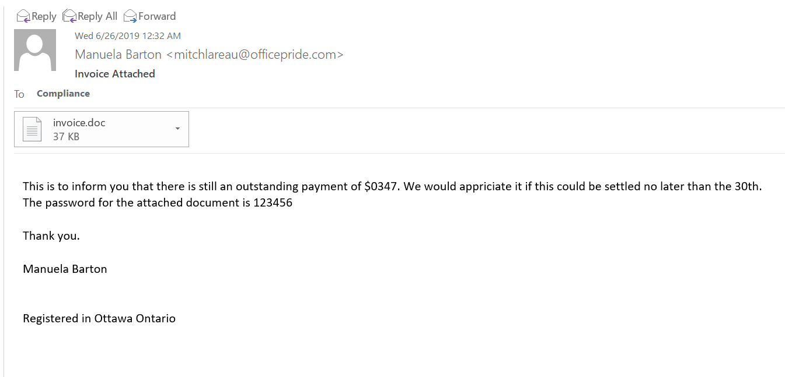
More Phishing Examples
Email addresses:
Not Microsoft
Unusual Signature
Name doesn’t match address!
Unexpected Attachment!

Slide 12
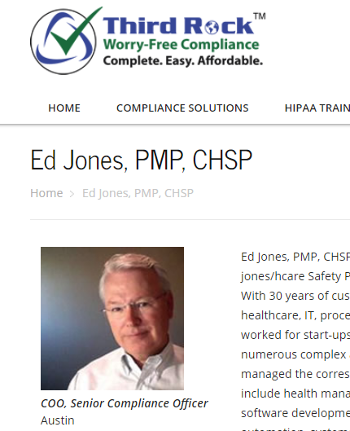
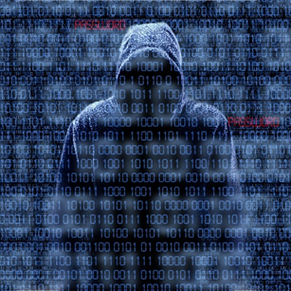
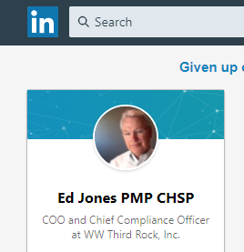
Spear Phishing
Spear phishing is a targeted attack based upon research of an organization and specific individuals. The email is typically “spoofed” to look internally created.
Personal
John Doe
Employer
John Doe PMP
John Doe PMP
Spear Phishing
I know you!
Professional
You are the Target!
John Doe PMP
Additional
February 22, 2017 – 803 people affected

Slide 13
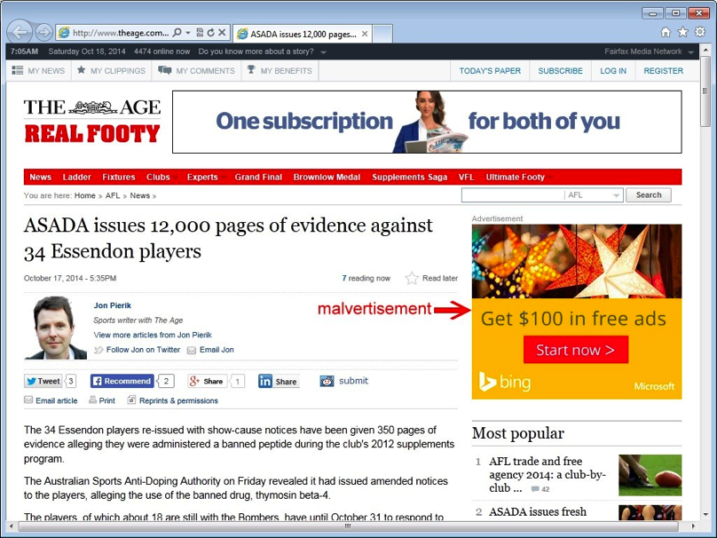
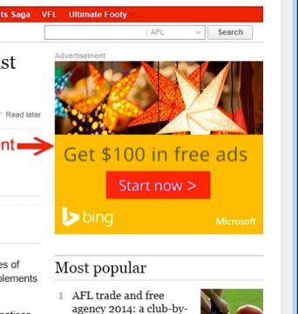
Malvertising
Uses Hijacked Ads to Deploy Malware!
Clicking on a Malvertising Ad is essentially the same as clicking on a phishing email link!
Image: http://news.softpedia.com/news/CryptoWall-2-0-Delivered-Through-Malvertising-On-Yahoo-and-Other-Large-Sites-462970.shtml#sgal_0
Notes:
This is what malvertising looks like—just an ordinary advertisement.

Slide 14
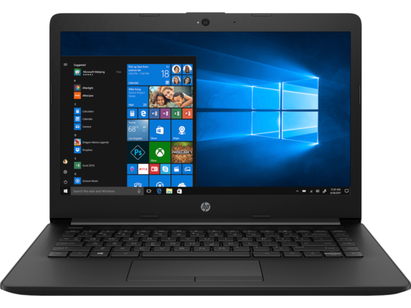
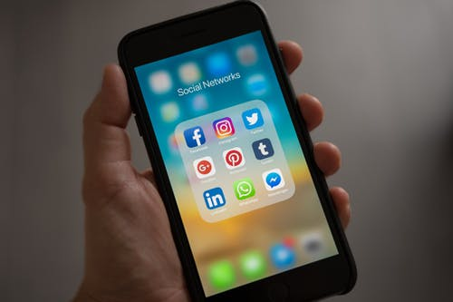
Activities: Work vs. Personal
Your Workstation
Your Smartphone
Used for:
Work
Used for:
Surfing the Web
Instagram
Shopping
Texting
Music
Facebook
Pinterest
Gaming
Movies

Slide 15
Methods of Attack for Ransomware
$
Command & control
and
malicious infrastructure
Compromised Sites and Malvertising
Backups (2)
MyPractice.com
Web Redirect
Exploit or phishing domains
Angler
Nuclear
Rig
Med device
File Drop
Web Link
Encryption Key
Data Theft
“Backdoor”
Phishing emails
Detonation
Ransomware
Med
Scanner
Data - ePHI
Email Attachment or Hyperlink
Firewalls
Printer/
Copier
Vital sign
machine
EHR
Step 1 – Breach external defenses
Step 2 – Lateral movement

Slide 16
Insider Threats
As hard to detect as any other Cyber Threat!
Insider Threat: Early Warning Indicators
Poor performance appraisals
Vocal dissatisfaction with the organization and policies
Difficult relationships with coworkers
Working odd hours
Financial distress
Leaving the company
Hindsight is 20/20!
Prevention
Use the principle of Least Privileges across the organization
Do not use privileged accounts for non-systems admin (routine) work
Adhere to and enforce change management processes
Discuss the Insider Threat at work meetings
Implement background checks, including credit checks
If you see something, say something!
A person using portable media to copy data
Someone working from another person’s workstation
Using someone else’s credentials
Requesting access to data or areas with no legitimate reason
Asking you to do something against policies or that is illegal

Slide 17
12 Signs you’ve been Hacked/Infected
Unusual activity or system behavior
Fake antivirus messages
Unwanted browser toolbars
Redirected Internet searches
Frequent random popups
Friends receive social media invitations from you that you didn’t send
Your online password isn’t working
Unexpected software installs
Your mouse moves on the screen without your assistance
Your anti-malware software, Task Manager or Registry Editor is disabled and can't be restarted
Ransom Message appears
Your online account is missing money

Slide 18
Suspect you’ve been Hacked/Infected?
DON’T PANIC! Panicked people make poor choices!
Malware often wants you to make a rushed decision.
Isolate your computer!
Disconnect ethernet cable or close Wi-Fi connection.
Leave the system running.
Contact your security officer immediately and report concerns!
Follow Security Officer’s instructions.
Implement Incident Response Plan.

Slide 19
Hardening Your Human Firewall
Perform a Security Risk Assessment to identify risks to address.
Formal HIPAA/Cyber Security training.
Use the organization’s workstations for business only!
Use phishing campaigns to train workforce.
Defeat spear phishing by confirming unusual or urgent request.
Avoid clicking on ads! Go directly to the website.
Report security incidents to your Security Officer! Let the entire organization learn from your incident or mistake!
Maintain strong passwords. Don’t share them!
Never use personal passwords at work or vice versa!
“Lock” your workstation when not in use.
Disable Remote Desktop Protocol (RDP) access. If used, ensure sessions are properly terminated when done.
Do not connect personal devices to the organization’s networks!
Document Security Incidents and learn from them.
Enforce your Sanctions Policy.

Slide 20
Hardening Your Systems
Inventory all of your sensitive and important data. Create dataflow maps.
Make sure backups work and can be restored in an acceptable amount of time.
Prevent connection of personal mobile devices (cell phones) to workstations.
Do not use privileged accounts for non-systems admin activities!
Create a standard workstation profile.
Turn on system and application logging.
Anti-virus is installed and auto-updating the software and definitions.
Disable macros across applications.
Set your web browsers to clear the cache at the end of each day.
Set a minimum length password greater than or equal to 12 characters
Set inactivity timeout to logout or lock user access. Require password to reactivate login/session.
Do not allow users to install software or browser plugins.
Prevent users from read/write from/to external removable media (USB, thumb drives).

Slide 21
Hardening Your Network
Inventory your network using software – you may be surprised what’s on it.
Segment a guest network from the work network – Wi-Fi or wired
Personal devices may connect to the guest network.
Do not broadcast the Wi-Fi work network.
Turn off wired network ports in public areas.
Lock all network equipment in cabinets, closets or rooms.
Log all workers, vendors and visitors when accessing network equipment.
Change all default device and application passwords.
Ensure firewall configuration limits ports to only needed ones.
Ensure firewall external login is disabled.
Ensure firewall password is 16 characters and difficult to break.
Have external penetration testing performed annually and after any network configuration or equipment changes.
Have network vulnerability scan performed at least annually.
Disable unnecessary shared folders and use non-descriptive names.

Slide 22
Thank You
Questions
consulting@tmlt.org
800-580-8658
compliance@thirdrock.com
512-310-0020

Slide 23
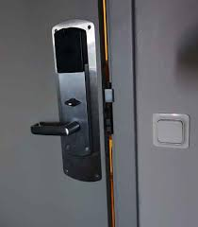
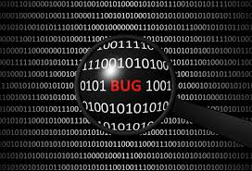
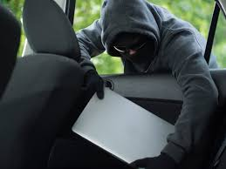
Terminology: Vulnerability & Threat
Module 2: Key Terminology
Vulnerability is a flaw or weakness in the system that could be exploited, accidentally or intentionally, resulting in a security breach. These include flaws or weaknesses in any of the following:
System security procedures
System design
System implementation
Access controls
Vulnerability + Threat = Security event
Threat is the potential for a person or thing to exploit a specific vulnerability, whether accidentally or intentionally.
Definitions per (NIST SP 800-30)

Slide 24
Terminology: Risk
Module 2: Key Terminology
Risk is the estimated impact of a potential event.
10
It is a function of two factors:
the probability of a particular threat exploiting a particular vulnerability
the severity of the impact on the organization if the event occurs.
HIGH RISK
IMPACT
MEDIUM RISK
LOW RISK
0
0
PROBABILITY
10
RISK = Probability (vulnerability + threat) x Impact severity
Notes:
Each threat and vulnerability poses a particular level of risk.
Example: Unauthorized visitor stealing an unsecured mobile device.

Slide 25
Cyber Security Terminology - continued
Attack vector: The path or means by which a hacker can gain access to a computer or network server in order to deliver a payload or malicious outcome.
Brute force attack: The attempt to gain access to a network using repeated guesses at passwords or Data Encryption Standard keys.
Darknet: Hidden websites on the Internet, only accessible using non-standard protocols—most famously the Tor browser. Sites on the darknet are not indexed and do not appear on search engines.
Distributed denial-of-service (DDoS) attack: Distributed denial-of-service is the easiest and, therefore, most common type of black hat hacking attack. The attackers use multiple hosts to send requests to a target site at such a rate that it crashes.
Malware: Short for "malicious software," malware is any program or file embedded into a system to run an unauthorized process for the purposes of capturing information, sabotaging the system, holding it for ransom, or other negative actions.
Malvertising: The use of online advertising to spread malware. Malvertising involves injecting malicious or malware-laden advertisements into legitimate online advertising networks and web sites.

Slide 26
Cyber Security Terminology - continued
Man-in-the-middle (MitM) attack: A type of attack in which the actor intercepts, alters, or eavesdrops on data as it travels between the sender and recipient. An example of this is intercepting messages through an unencrypted Wi-Fi connection.
Phishing: A social engineering hack in which the actor attempts to trick a target into delivering access to the target’s system.
Ransomware: A subset of malware in which the data on a victim's computer is locked, typically by encryption, and payment is demanded before the ransomed data is decrypted and access returned to the victim.
Social Engineering – Cyber attacks based on human psychology and curiosity in order to compromise their targets’ information.
Spear Phishing is phishing, but with information targeting a specific individual or organization.
Spoofing: Sending an email disguised to look like it is coming from someplace besides its actual origin. The IP address may be changed, the email address may mimic a known domain, and the email formatting may imitate the design attached to a well-known company or site.
Zero-day: a software security flaw that is known to the software vendor but doesn't have a patch in place to fix the flaw.

Slide 27
More Social Engineering Attack Vectors
Pretexting: Attackers focus on creating a good pretext, or a fabricated scenario, they can use to try and steal their victims’ personal information. The attacker builds a credible story that leaves little room for doubt on the part of their target.
Baiting: Similar to phishing attacks, but has the promise of an item, prize, or goods that hackers use to entice victims. Baiters may offer users free music or movie downloads if they surrender their login credentials to a certain site. A notable example is attackers infected dozens of USBs with a Trojan keylogger virus then dispersed them around an organization’s parking lot. Employees found the USBs, plugged them into their computers, and infected their organization’s networks.
Quid Pro Quo: Fraudsters impersonate IT service people offering assistance promise a quick fix in exchange for the employee disabling their AV program allowing installation of malware.
Tailgating: Attacker who lacks the proper authentication follows an employee into a restricted area.

Slide 28
Additional Phishing Precautions
DO NOT OPEN attachments you are not expecting.
DO NOT CLICK ON HYPERLINKS except for emails you are completely confident are legitimate.
DO NOT CALL a number provided in an email. If you believe the contact could be legitimate, call the business directly using a number provided on an account statement or the official company website.
If completing a work task requires online communication with an outside provider or facility, USE SECURE EMAIL ONLY.
DO NOT install or use any software not approved by your organization.
If you suspect you clicked on a phishing link or open a bad attachment, call your IT department immediately!
It’s better to be safe than sorry!
Source: Federal Trade Commission (http://www.consumer.ftc.gov/articles/0003-phishing)
Notes:
A few final Phishing precautions and reminders that can protect you at home as well as at work.
Give an example of each.
Attachments – these might be lab values, but they weren’t sent through secure email. Call the lab directly to verify they are the source, then remind them to always use secure email.
Calling a number in email.

